Slide 1
Task-13 Deploy the ci/cd pipeline to production

Slide 2
What is Jenkins?
Jenkins is a tool that is used for automation. It is mainly an open-source server that allows all the developers to build, test and deploy software. It is written in Java and runs on java only. By using Jenkins we can make a continuous integration of projects(jobs) or end-to-endpoint automation.
What is Jenkins CI/CD Pipeline?
Jenkins CI/CD stands for Continuous Integration / Continuous Deployment first let us try to understand what is a pipeline. In computing, a pipeline is a set of stages or processes linked together to form a processing system. Each stage in the pipeline takes an input, processes it in accordance with a set of rules, and then sends the outputs to the stage that follows. Frequently, the pipeline’s overall output is its final step’s output. like the procedures outlined below.
Test code
Build Application
Push Repository
Deploy to Server
All the steps mentioned above will perform in sequence one after the other if any step/stage get failed it will not move forward to another step/stage until the previous step got a success. To master Jenkins and its integration in CI/CD pipelines, the DevOps Engineering – Planning to Production course provides detailed lessons and real-world projects.

Slide 3
What is Jenkins Continuous Integration (CI)?
Jenkins Continuous integration means whenever new code is committed to remote repositories like GitHub, GitLab, etc. Continuous Integration (CI) will continuously build, tested, and merged into a shared repository.
Benefits of Continuous Integration (CI)
We can maintain the reports of the projects
Deployments can be made within the given time
Bugs can be found quickly.
What is Jenkins Continuous Deployment/Delivery (CD)?
Continuous Deployment
Continuous Deployment means automating the further stages of the pipeline automatically or manually deploying the application/code to different environments like Dev, Test, and Production. Automating the build is the main component of Continuous Integration and Continuous Deployment.
Continuous Delivery
Each and every build that passed all automated tests and was able to be fully automated and delivered into production only required one click of human intervention is called Continuous Delivery.

Slide 4
SONARQUBE JENKINS INTEGRATION
What is Sonarqube?
SonarQube is an open-source platform that is used to inspect code quality continuously. It performs automated code reviews by scanning the code for possible issues like bugs, vulnerabilities, bad code practices, security risks. and way more. SonarQube supports a vast number of programming languages and plugs into CI/CD pipelines with the help of which the quality of the code is continuously checked, and necessary actions are done to improve it.
Some Key Features In Sonarqube:
Static Code Analysis
Code Quality Metrics
Security Vulnerabilities
Language Support
Integration with CI/CD Tools

Slide 5
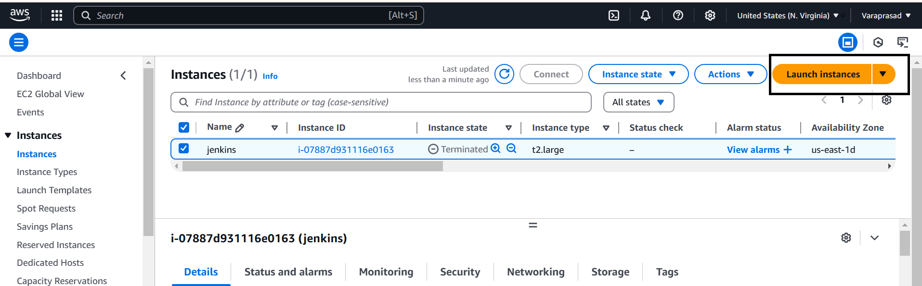
Sonarqube Jenkins Integration:
Step-1:
First Need to Create one EC2 instance in AWS Console
First click on launch instance in EC2 dashboard

Slide 6
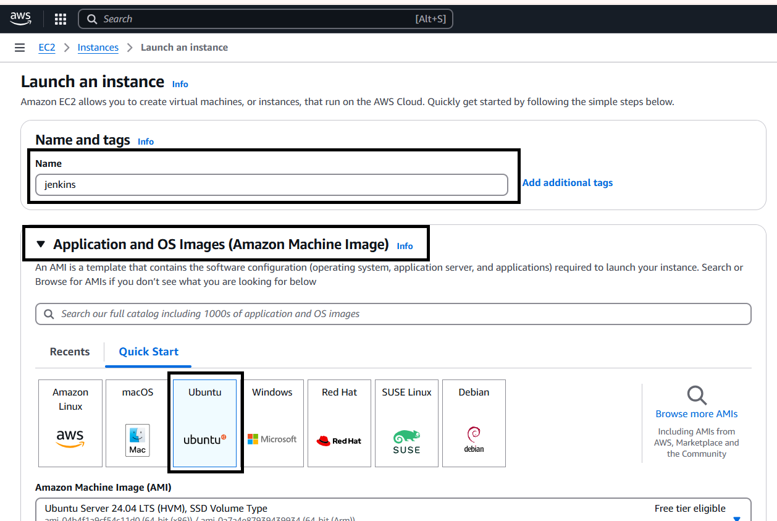
After click on the Launch Instance Need to provide Name and select AMI (like Linux,Ubuntu etc…,)

Slide 7
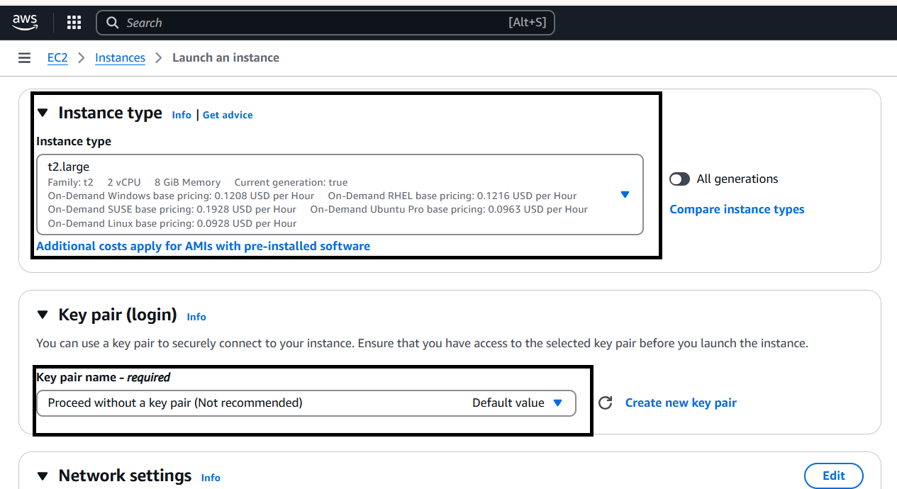
Then select Instance Type as t2.large and select select any existing key pair or create new key by click create new key pair.

Slide 8
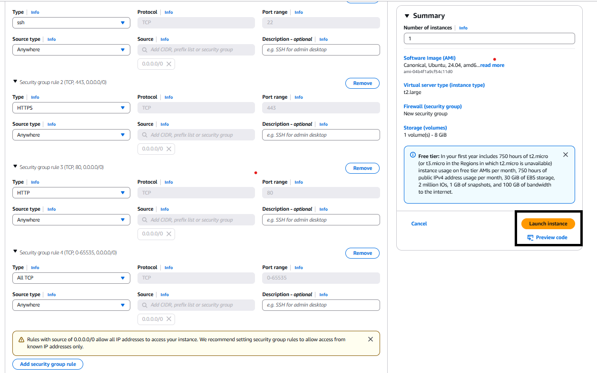
Then go the Network settings and then Allow the HTTP & HTTPS then click on Edit then add security group with All TCP then click on Launch Instance.

Slide 9
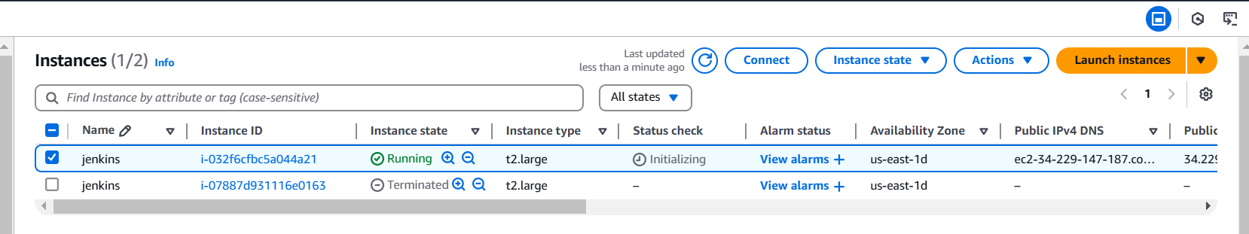
After the Instance Created then Connect the instance with any tool(GIT,Mobaxterm etc..,) with SSH Key .

Slide 10
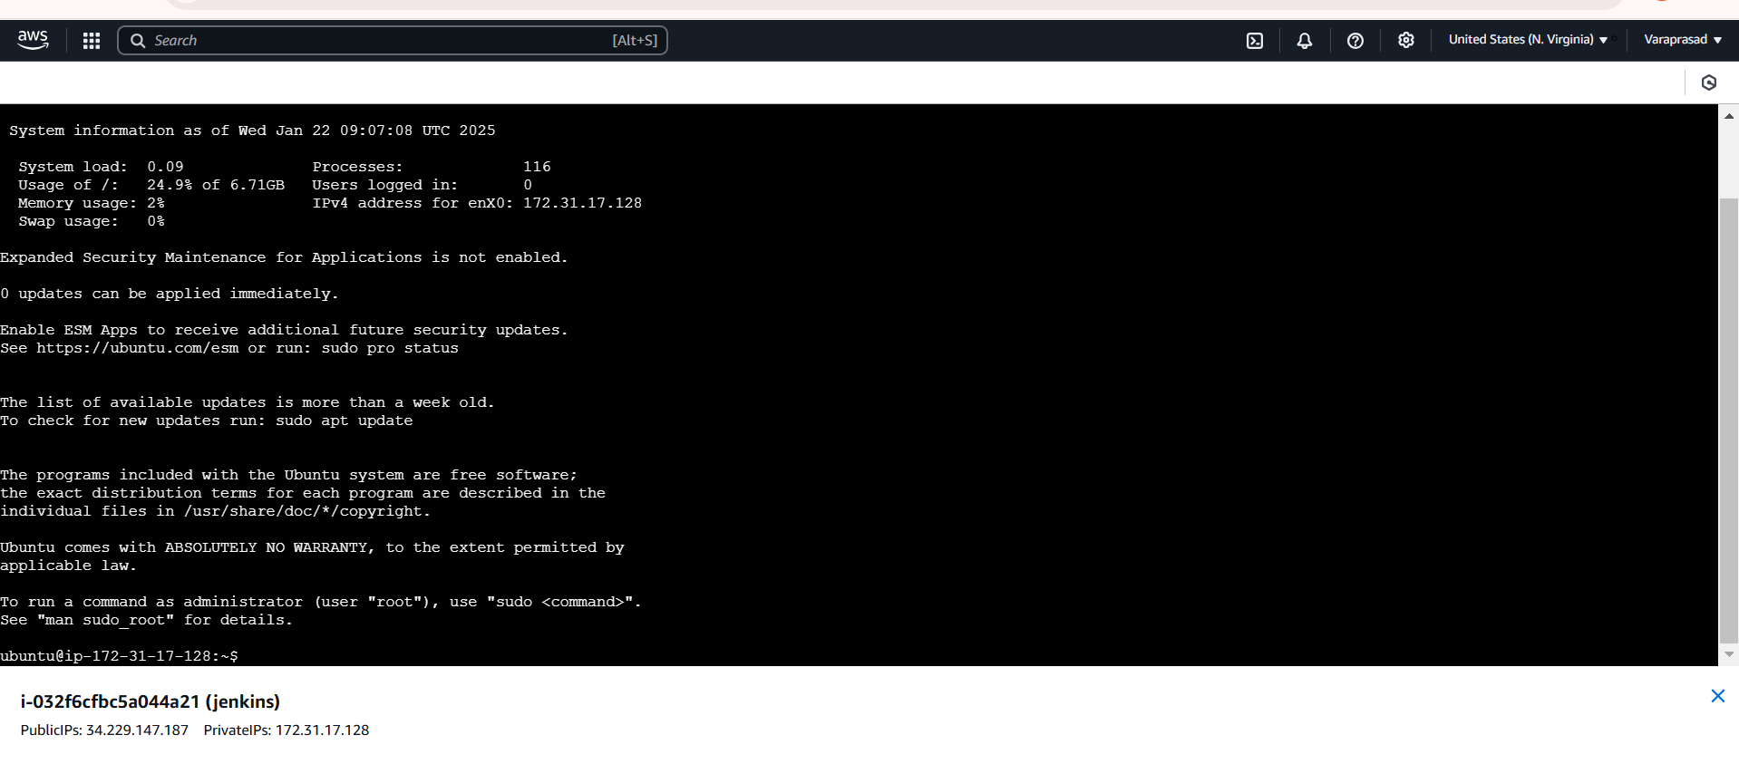
After Copy the SSH link paste that in any tool (GIT,Mobaxterm etc..,) to connect with AWS.

Slide 11
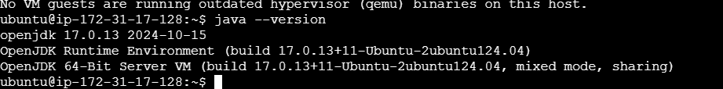
Step-2:
Now install Java,Maven,Jenkins,sonarqube and Docker in the instance for Integration.
To Install Jenkins follow below commands.
sudo apt update -y
sudo apt upgrade –y
sudo wget -O /usr/share/keyrings/jenkins-keyring.asc \ https://pkg.jenkins.io/debian-stable/jenkins.io-2023.key
echo "deb [signed-by=/usr/share/keyrings/jenkins-keyring.asc]" \ https://pkg.jenkins.io/debian-stable binary/ | sudo tee \ /etc/apt/sources.list.d/jenkins.list > /dev/null
sudo apt-get update
Now need to Install Jdk in Instance for that use
sudo apt install openjdk-17-jre-headless
Java –version

Slide 12

Then need to Install Maven In the Instance using
sudo apt install maven -y
Then need to Install Jenkins before install need to add Keys for Jenkins
curl -fsSL https://pkg.jenkins.io/debian-stable/jenkins.io-2023.key | sudo tee \ /usr/share/keyrings/jenkins-keyring.asc > /dev/null
echo deb [signed-by=/usr/share/keyrings/jenkins-keyring.asc] \ https://pkg.jenkins.io/debian-stable binary/ | sudo tee /etc/apt/sources.list.d/jenkins.list > /dev/null
sudo apt-get install jenkins –y
Jenkins –version
Then start the jenkins by using
sudo systemctl start jenkins

Slide 13
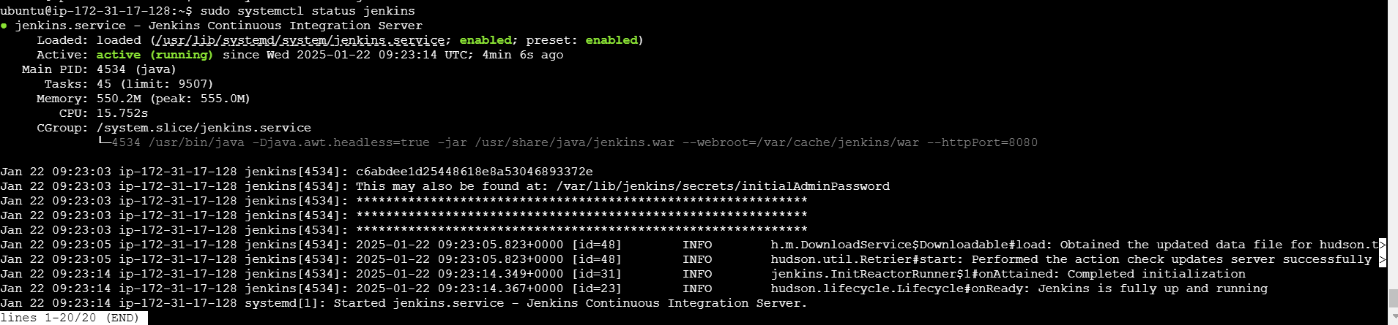
After starting the Jenkins need to checkstatus of Jnekins it is active or not by using
sudo systemctl status jenkins

Slide 14
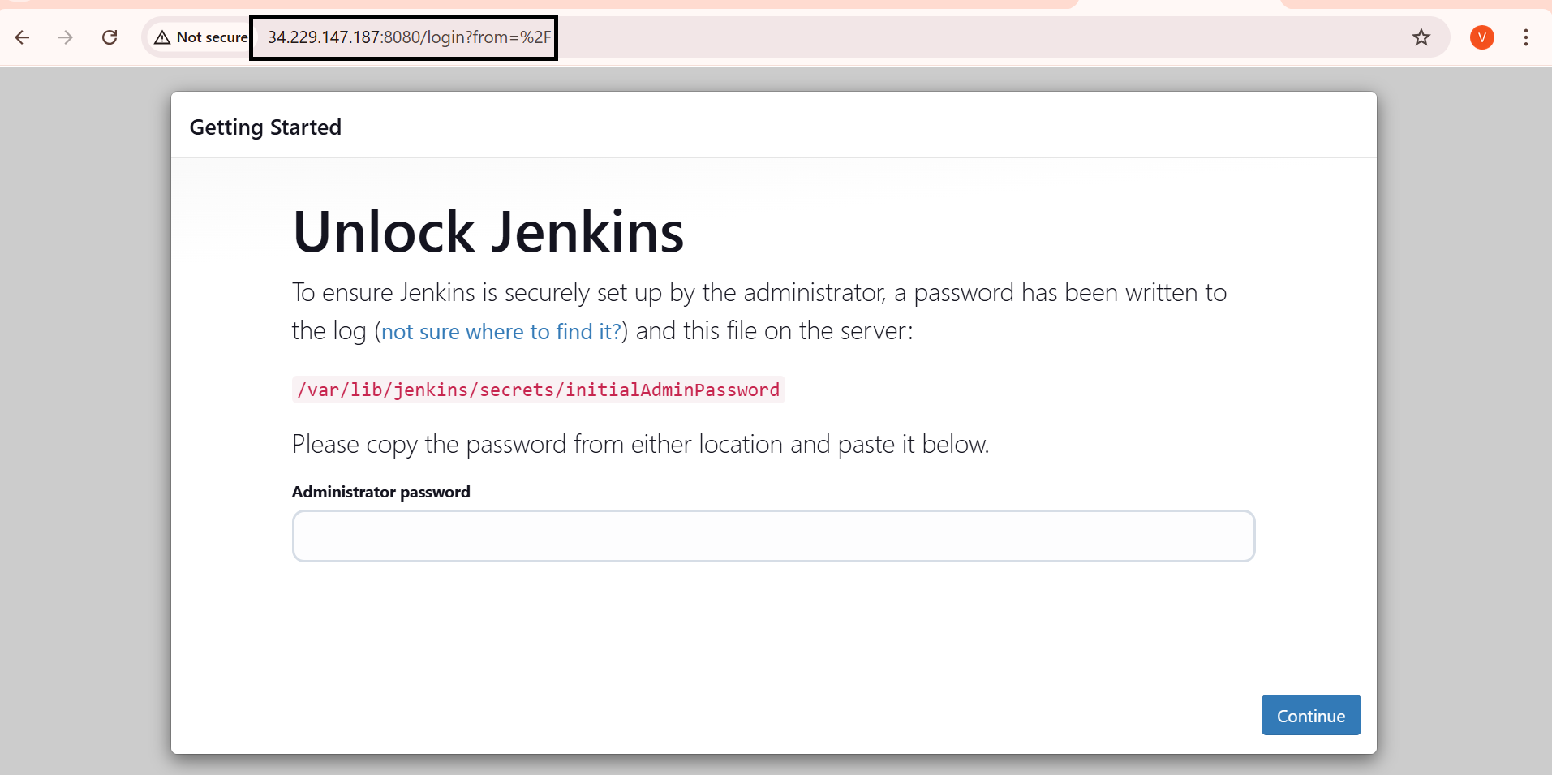
Then connect to the Jenkins dashboard by using Instance public IPV4 address:8080

Slide 15
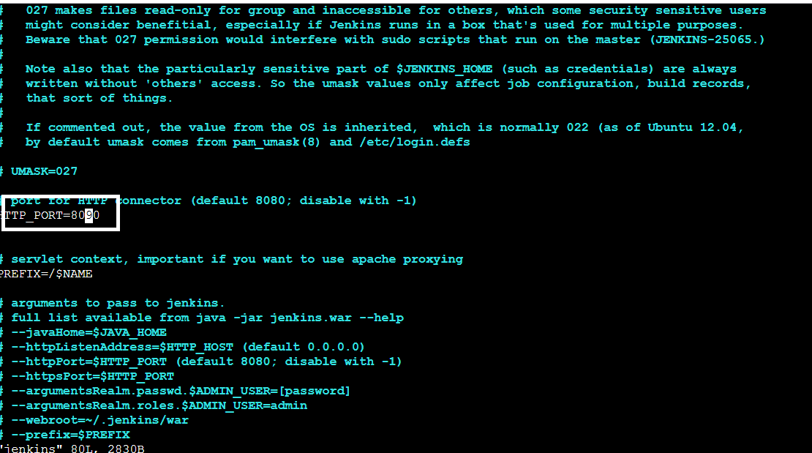
once Jenkins is installed and connected to dashboard then for this Application case, we are running Jenkins on another port. so change the port to 8090.
For changing to 8090 port first need to stop Jenkins by using
sudo systemctl stop jenkins
Then check the status of jenkins it is inactive or not by using
sudo systemctl status jenkins
Now we need to change the port to 8090 for that need to change the directory by using
cd /etc/default
After changing into directory need to go vi editor to change the port number by using
sudo vi jenkins

Slide 16
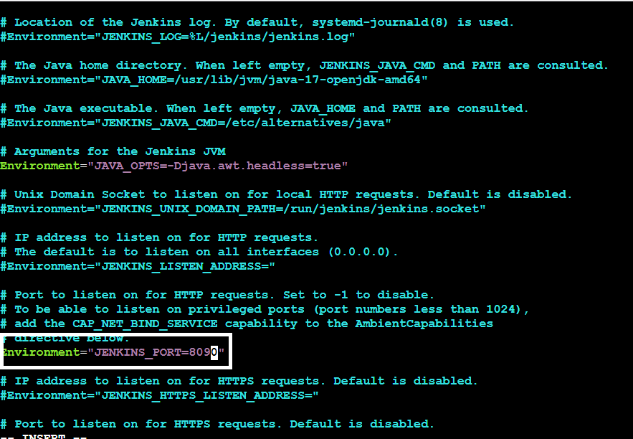
After exit from vi editor need to change to another directory by using
cd /lib/systemd/system
After changing into above directory need to got vi editor again by using sudo vi jenkins.service in this need to change the jenkins port to 8090 and then exit form vi editor

Slide 17
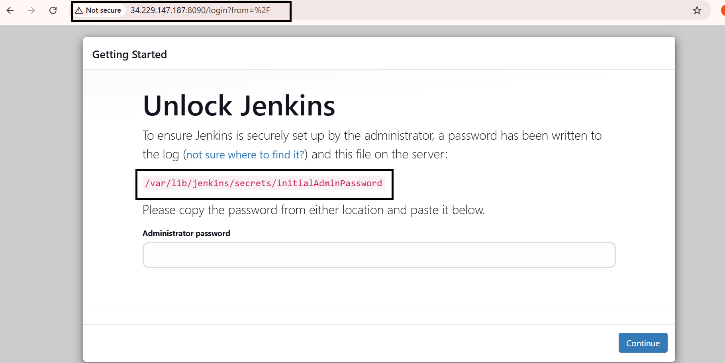
After exit from vi editor need to reload the jenkins server by using
sudo systemctl daemon-reload
Step-3:
Jenkins dashboard creation
Then restart the jenkins server by using
sudo systemctl restart jenkins
After restarting the service then connect the with 8090 port
Now Unlock Jenkins using an administrative password
To get need to copy var path and paste in Git by using sudo cat var path to get administrative password

Slide 18
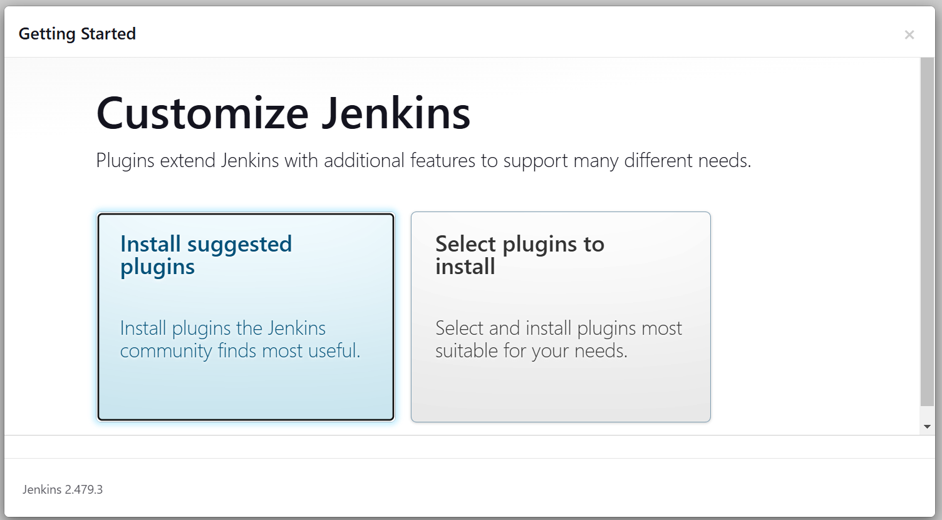
After unlocking the jenkins click on install the suggested plugins.

Slide 19
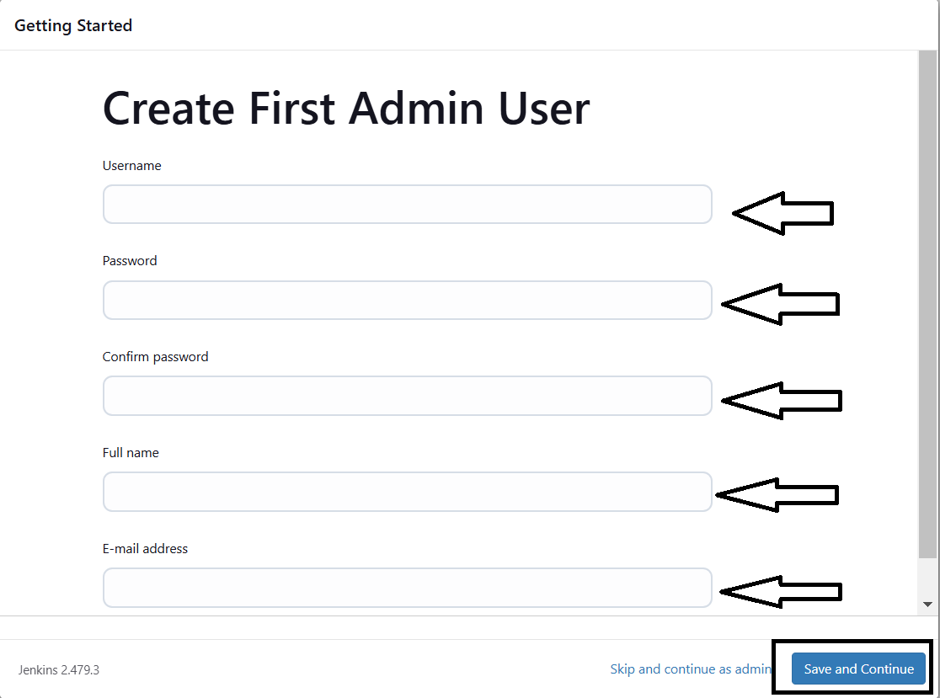
After successfully installation suggested we will get login page in that need to the enter below details
User name
Password
Conform Password
Full name
Email
After the all details need to
Click on save and continue
After click on save and
continue Jenkins dashboard
page will open

Slide 20
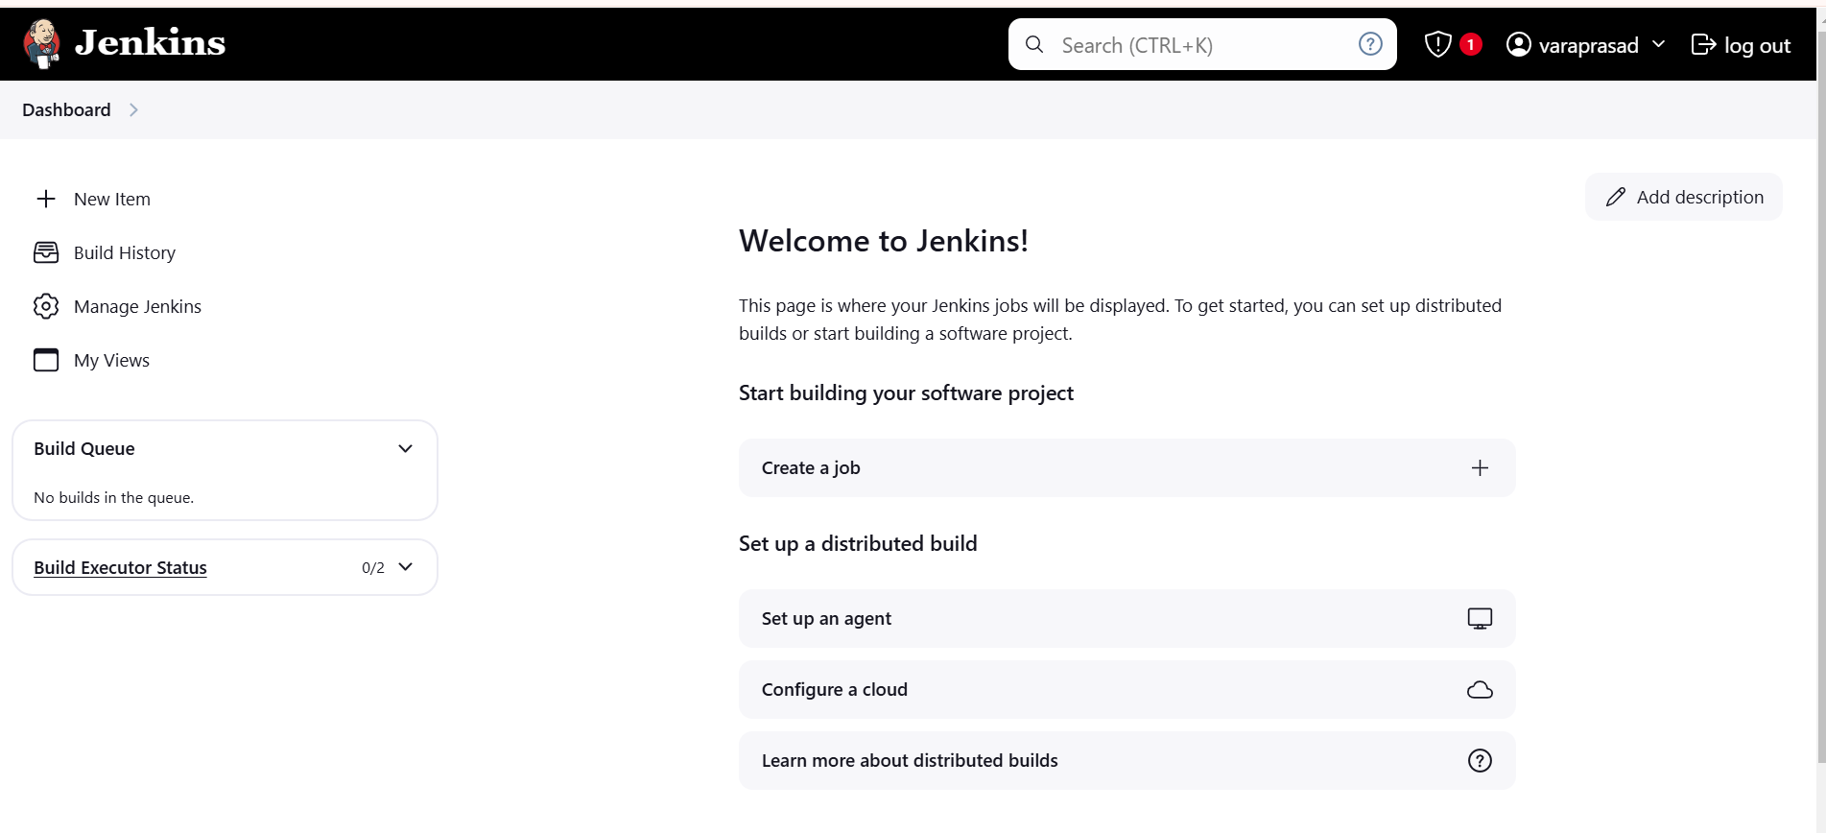
After created Jenkins Dashboard again got the Instance and install the docker

Slide 21
What is Docker?
Docker is an open-source platform that allows developers to automate the deployment, scaling, and management of applications inside lightweight, portable containers. These containers package an application with all its dependencies, ensuring that it runs consistently across different environments, such as development, testing, and production.
Step-4:
Need to Install Docker Instance and connect to the sonarQube with Docker Container by using below commands
sudo apt-get update
After update the tools need install Docker by using
sudo apt-get install docker.io -y
After Installing the docker create user in usermod by using
sudo usermod -aG docker $USER #my case is ubuntu
Then New group for docker by using
newgrp docker

Slide 22
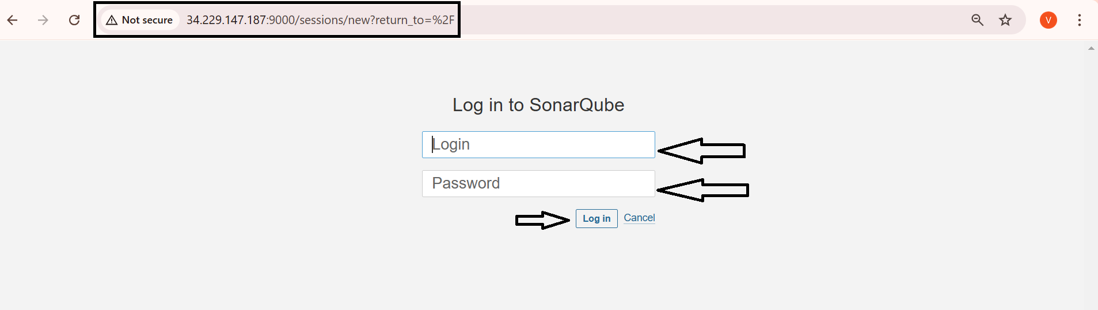
After the docker installation, we create a sonarqube container by using
docker run -d --name sonar -p 9000:9000 sonarqube:lts-community
Then connect the SonarQube by using Instance public IPV4address:9000 (SonarQube default port number)
Then login with login
Enter username as admin
Enter password as admin
Then click on login

Slide 23
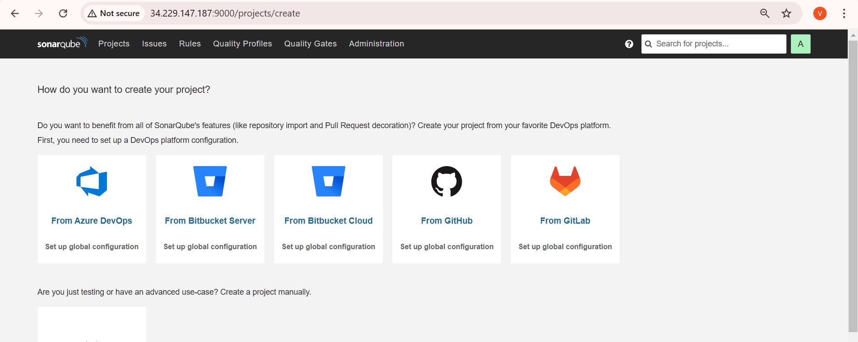
After click on the Login the SonarQube dashboard will open

Slide 24
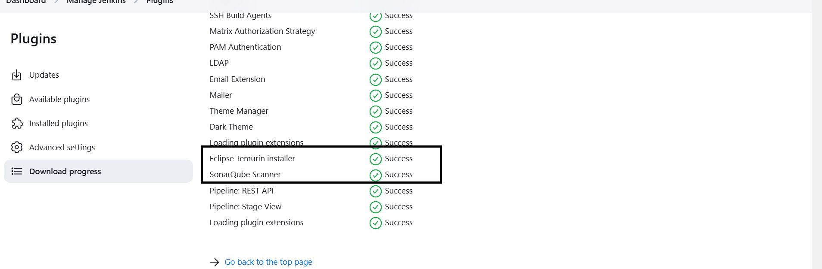
Step-5:
After completing of SonarQube connectivity need to go to the jenkins dashboard and start build the project
Step-6:
First login into Jenkins dashboard and the go to the manage Jenkins and select plugins in plugins need to select available plugins and install the required plugins
Eclipse Temurin Installer (Install without restart)
SonarQube Scanner (Install without restart)

Slide 25
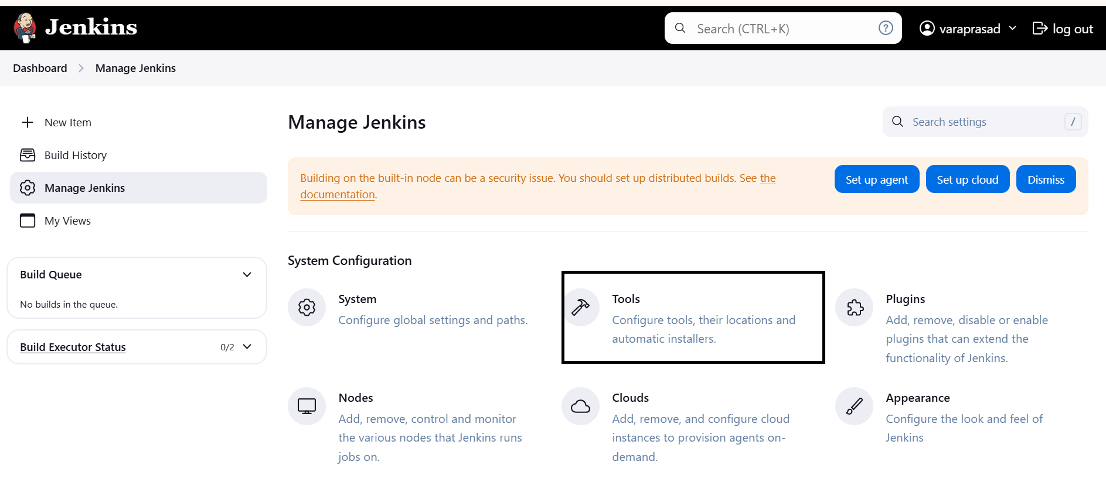
Step-9:
Then again go to the Manage Jenkins and select Tools.

Slide 26
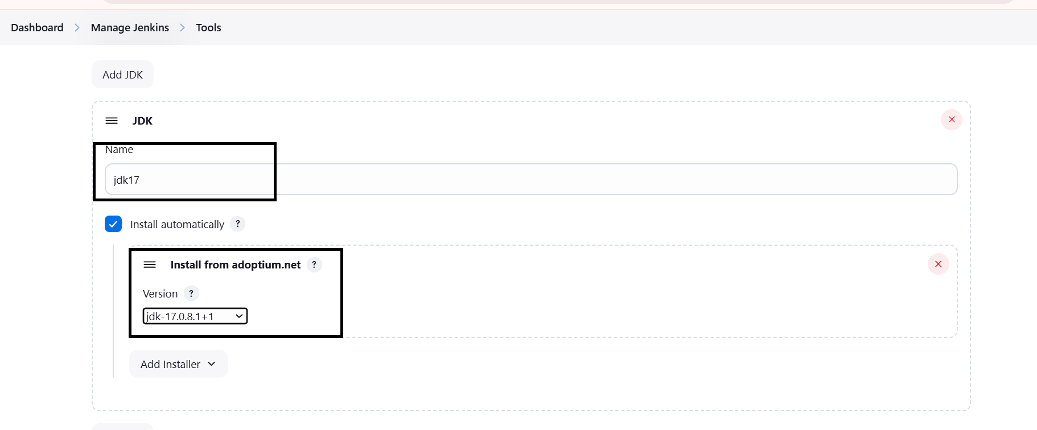
In Tools need to add jdk installation and maven installation
Add jenkins Installation
Name
Java Version (jdk-17.0.8.1+1)

Slide 27
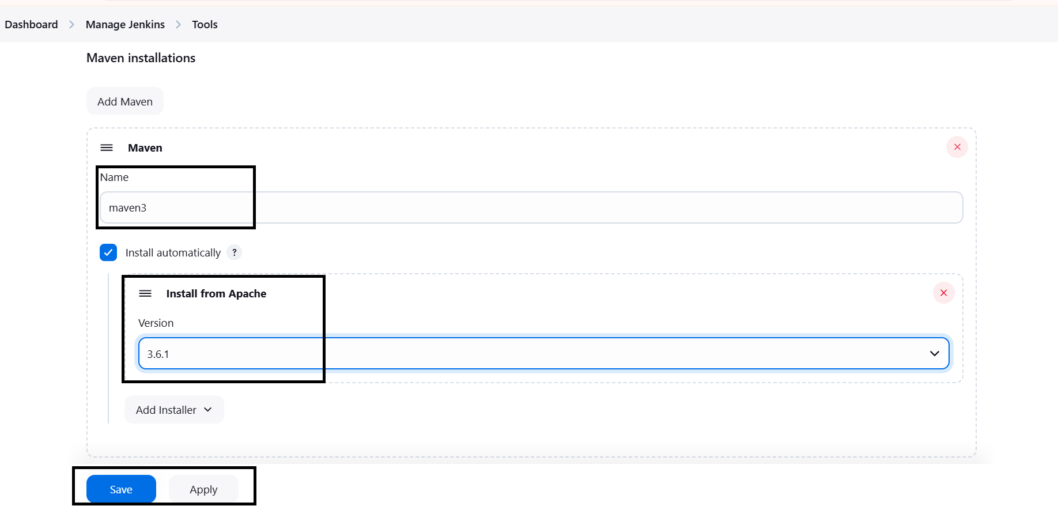
Then again In Tools need to add maven installation and maven installation.
Add maven
Name
Maven Version (3.6.0)
Then Apply and Save

Slide 28
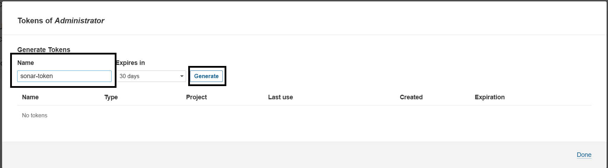
Step-10:
Configure Sonar Server in Manage Jenkins
Create a token with a name and generate:

Slide 29
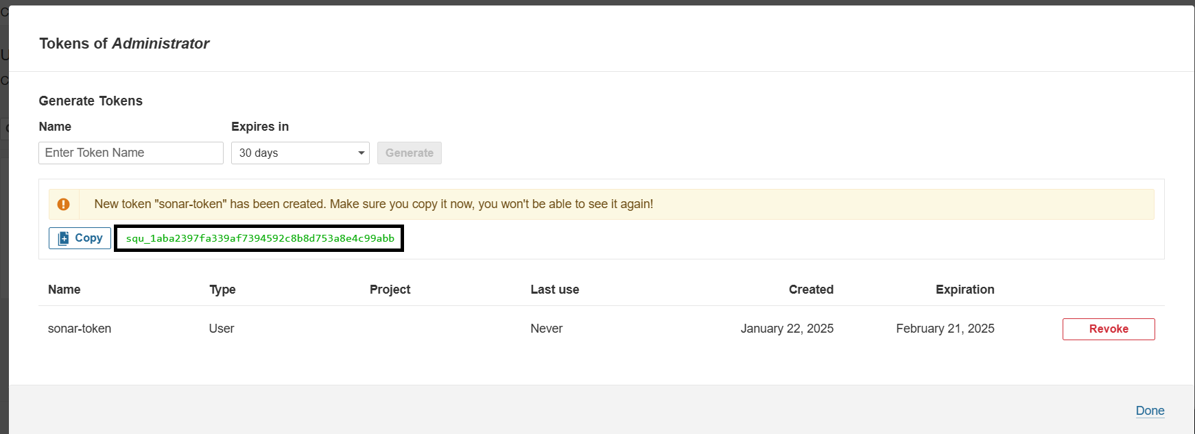
Copy token:

Slide 30
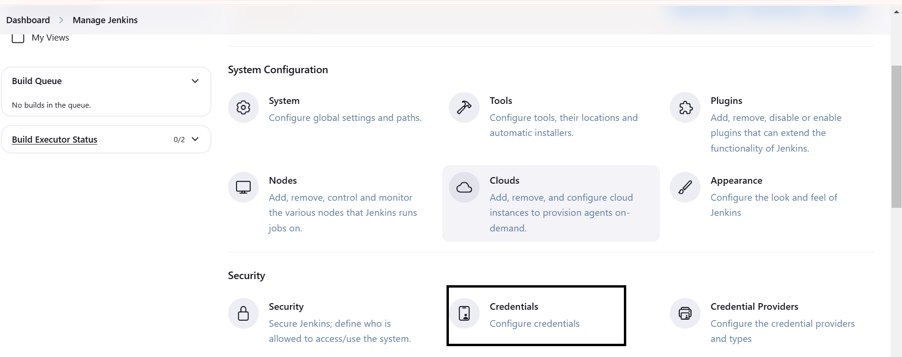
Go to Jenkins Dashboard → Manage Jenkins → Credentials

Slide 31
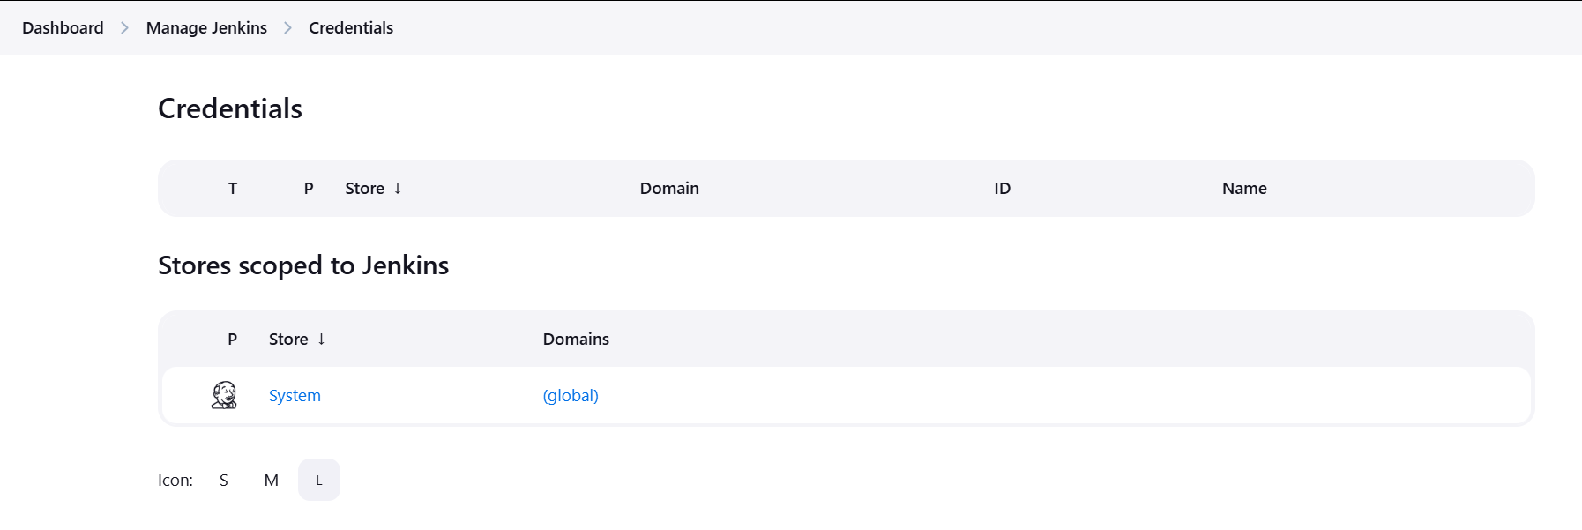
In credentials click on global :

Slide 32
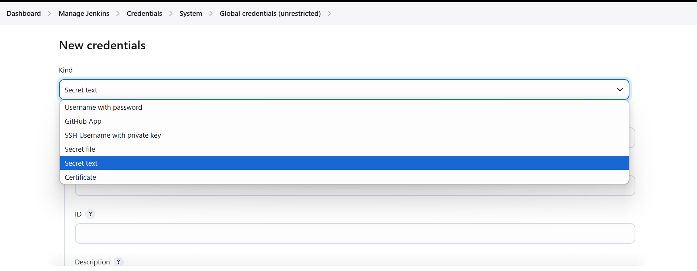
Add Secret Text:

Slide 33
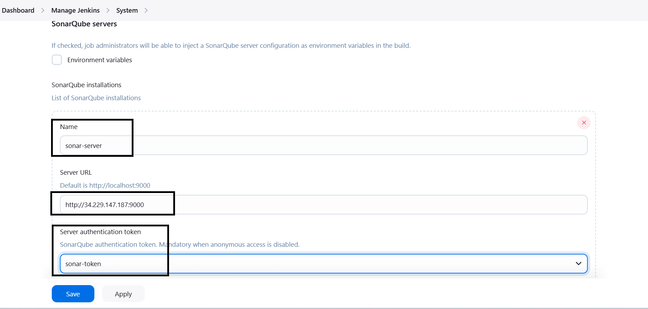
Now, go to Dashboard → Manage Jenkins → System
Here give name and paste url of sonar cube.

Slide 34
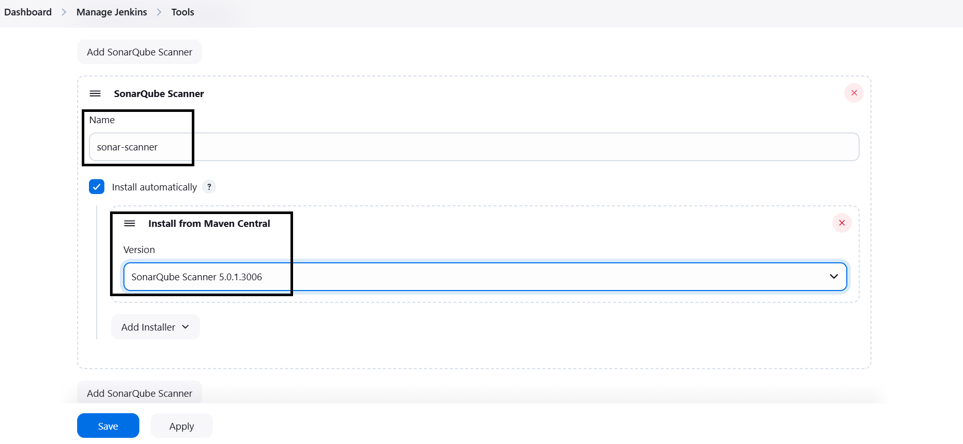
The Configure System option is used in Jenkins to configure different server
Global Tool Configuration is used to configure different tools that we install using Plugins
We will install a sonar scanner in the tools.

Slide 35
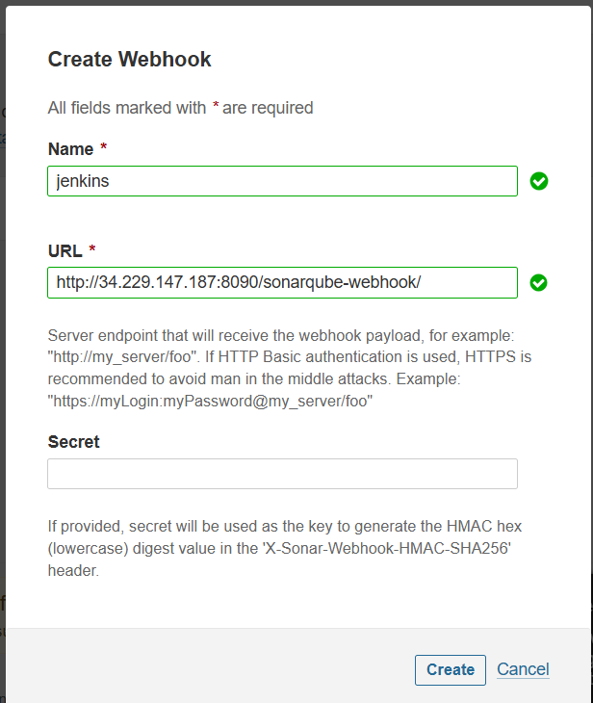
In the Sonarqube Dashboard add a quality gate also
Administration--> Configuration-->Webhooks

Slide 36
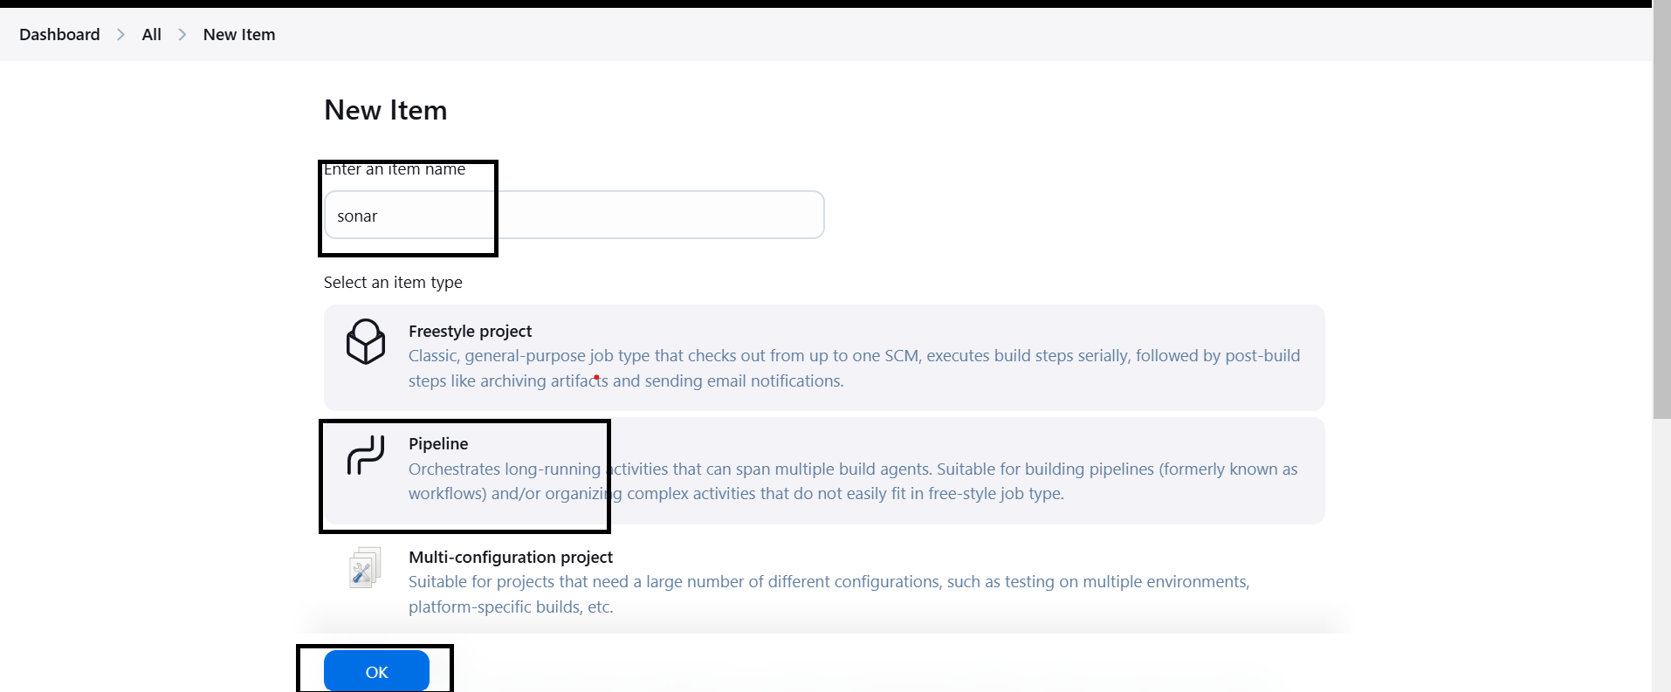
After providing all the information need to Create a new project with Pipeline

Slide 37
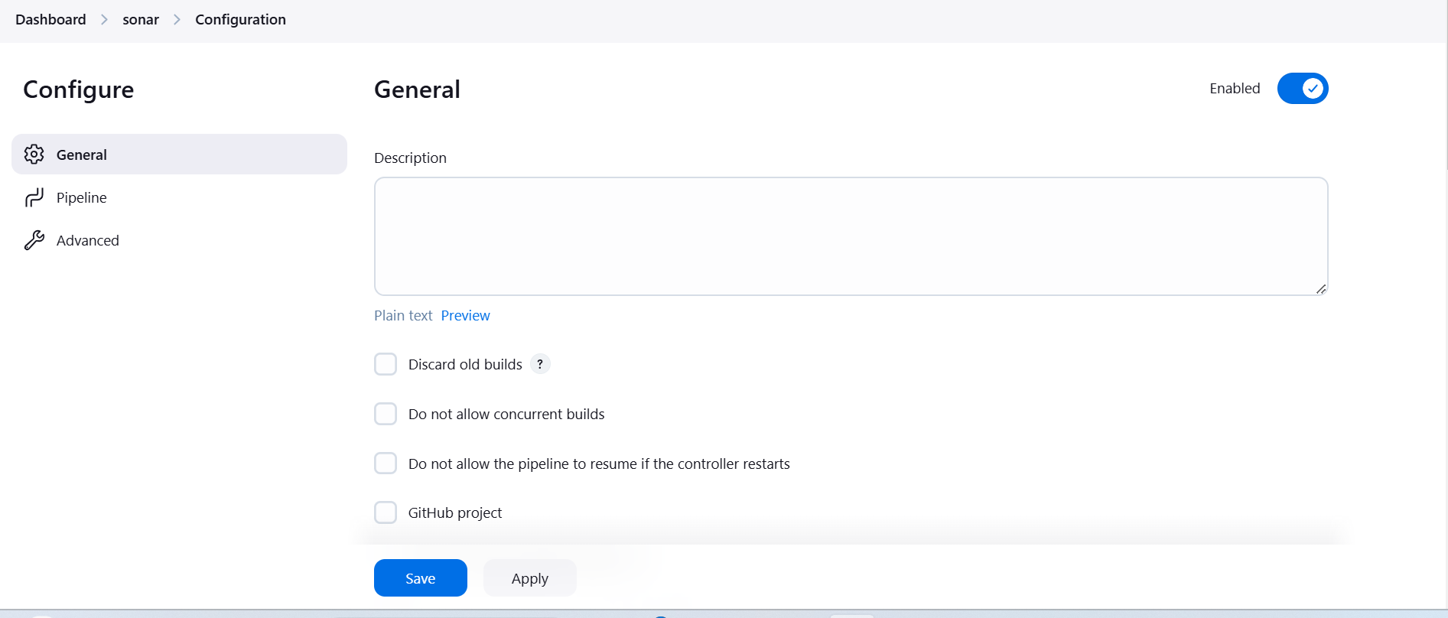
After Click on Ok the configure page will open
In General Tab need to provide the decesription

Slide 38
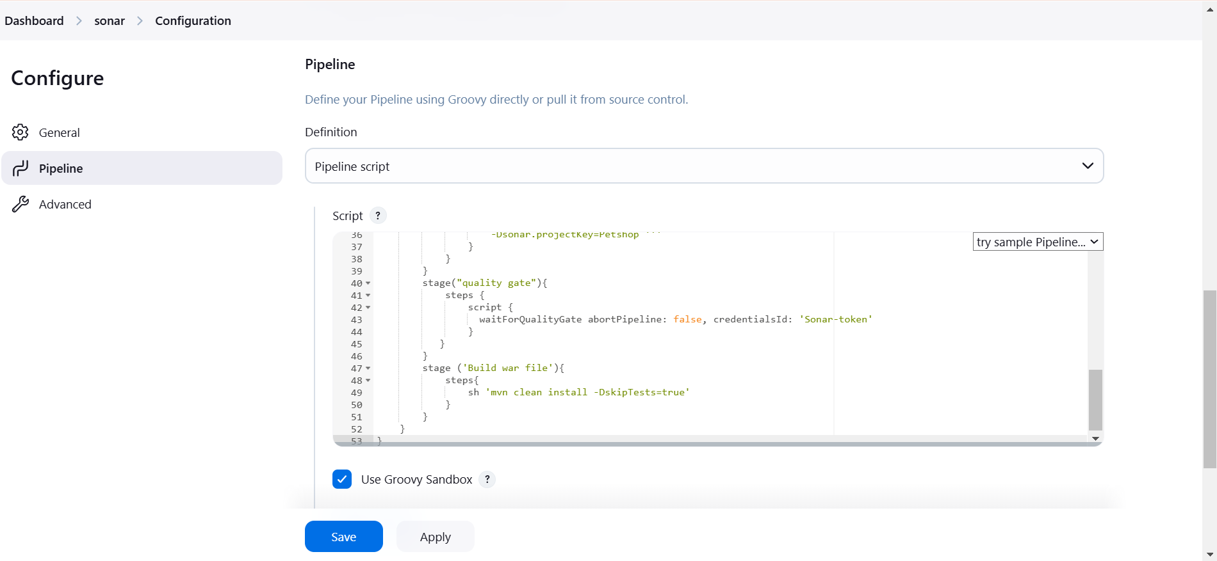
Then go the Pipeline in Configure and then provide the pipeline script Then Apply and Save.

Slide 39
In the pipeline script sonar analysis use this code :
pipeline{
agent any
tools {
jdk 'jdk17'
maven 'maven3'
}
environment {
SCANNER_HOME=tool 'sonar-scanner'
}
stages{
stage ('clean Workspace'){
steps{
cleanWs()
}
}

Slide 40
stage ('checkout scm') {
steps {
git 'https://github.com/Venn1991/jpetstore-6.git'
}
}
stage ('maven compile') {
steps {
sh 'mvn clean compile'
}
}
stage ('maven Test') {
steps {
sh 'mvn test'
}
}
stage("Sonarqube Analysis "){
steps{
withSonarQubeEnv('sonar-server') {
sh ''' $SCANNER_HOME/bin/sonar-scanner -Dsonar.projectName=Petshop \
-Dsonar.java.binaries=. \
-Dsonar.projectKey=Petshop '''
}
}
}

Slide 41
stage("quality gate"){
steps {
script {
waitForQualityGate abortPipeline: false, credentialsId: 'Sonar-token'
}
}
}
stage ('Build war file'){
steps{
sh 'mvn clean install -DskipTests=true'
}
}
}
}

Slide 42
Sonar analysis:
Sonar analysis typically refers to the use of sonar technology to analyze and map underwater environments. Sonar, which stands for Sound Navigation and Ranging, works by emitting sound waves and then measuring the time it takes for those waves to bounce back after hitting an object or surface. This information is used to create maps of the seabed, detect underwater objects, and analyze water conditions.
There are a couple of primary types of sonar analysis:
Active Sonar:
The sonar system sends out a pulse or sound wave and waits for it to bounce back from objects. This is commonly used for mapping the ocean floor or locating objects.
Passive Sonar:
This type listens to the sounds already present in the water, such as from marine life, ships, or other activities. It's often used for surveillance or to detect underwater activity.
Sonar is widely used in a variety of fields, including oceanography, marine biology, underwater navigation, military applications (like submarines), and for detecting things like shipwrecks or underwater geological features.

Slide 43
Quality gate:
A quality gate is a set of criteria or rules used to assess the quality of code or software at specific points in the development process. It’s most commonly used in software development and continuous integration (CI) practices to ensure that only high-quality code makes it through to the next stage of the development cycle.
In tools like SonarQube (a popular code quality analysis tool), a quality gate is essentially a set of conditions that must be met for the code to be considered "acceptable." If the code doesn't meet these conditions, it is flagged, and further action (like fixing issues) is required before proceeding.
Key components of a quality gate can include:
Code coverage: A percentage of the code that is covered by automated tests. For example, a quality gate might require at least 80% of the code to be covered by tests.
Code duplications: Limiting the amount of duplicated code in the system, as excessive duplication can lead to maintenance problems.
Bug count: Ensuring that no new critical or major bugs are introduced.
Code smells: Ensuring that the code doesn’t introduce unnecessary complexity or poor practices that could harm maintainability.
Security vulnerabilities: Ensuring that no security issues are present in the codebase.

Slide 44
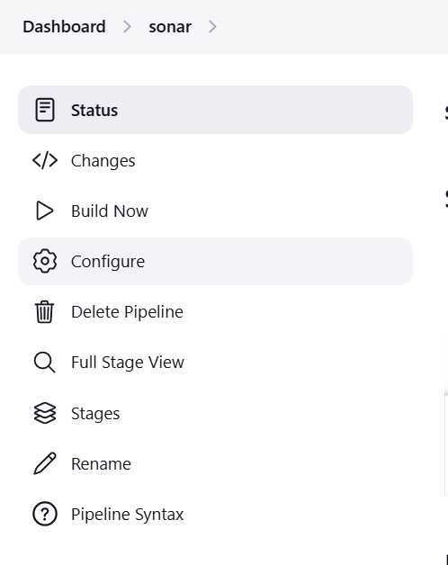
After save the configure page then click on Build Now

Slide 45
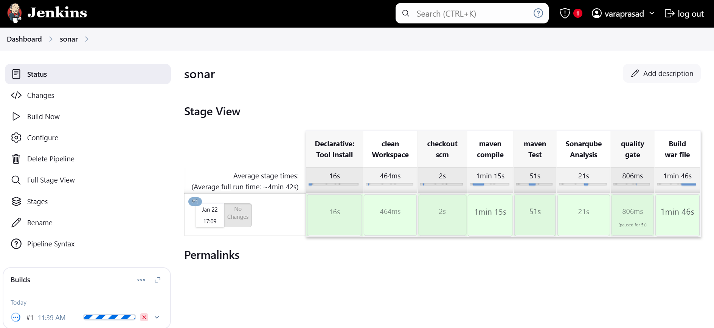
After Click on Build Now you will get success output.

Slide 46
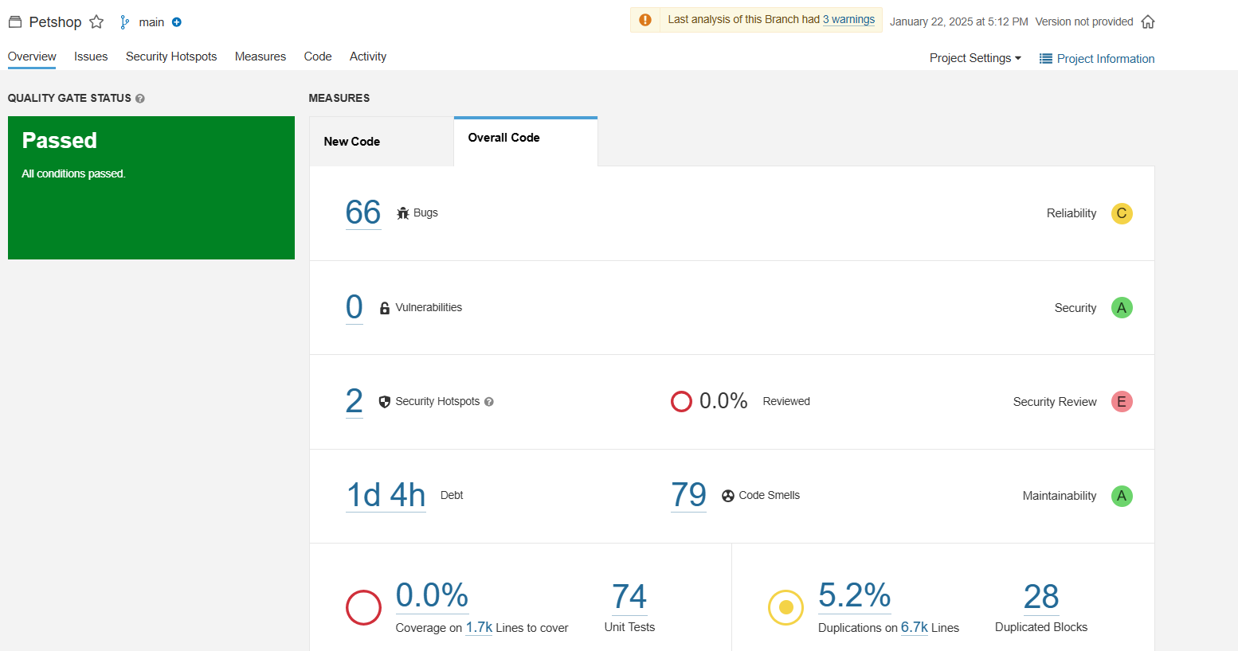
After success sonar analysis go to sonarqube , in sonarqube we build petshop project ,here we find some bugs and quality gate status is shown below.

Slide 47
Expole the above image is given below :
Quality Gate Status: The project has passed the quality gate, which means it meets the predefined quality standards.
Measures:
Reliability: 66 bugs were found in the code.
Security:
No vulnerabilities were detected.
2 security hotspots were identified, which are areas of code that might have security vulnerabilities.
0% of the code has been reviewed for security issues.
Maintainability:
79 code smells are present, indicating areas of code that could be improved for better maintainability.
0% of the code is covered by unit tests.
There are 28 duplicated code blocks.
5.2% of the code is duplicated.

Slide 48
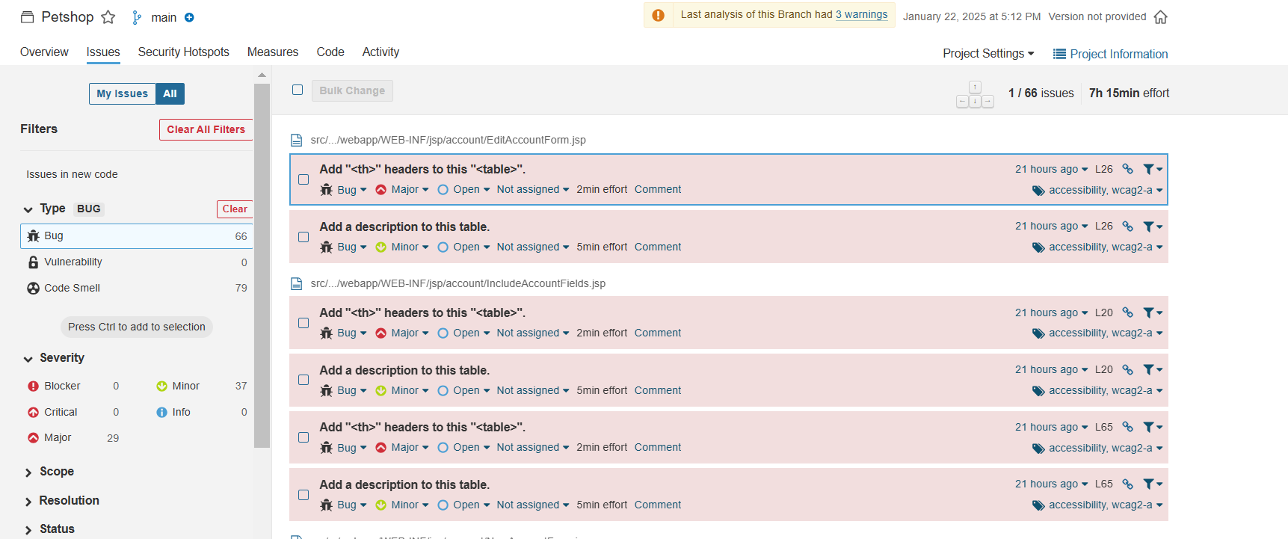
Lets see some bugs first .
Bug:A bug in software development refers to an error, flaw, or unintended behavior in a program that causes it to operate incorrectly or produce an unexpected result. Bugs can occur at any stage of the software development life cycle, from coding to deployment, and can range from simple UI issues to critical system failures.

Slide 49
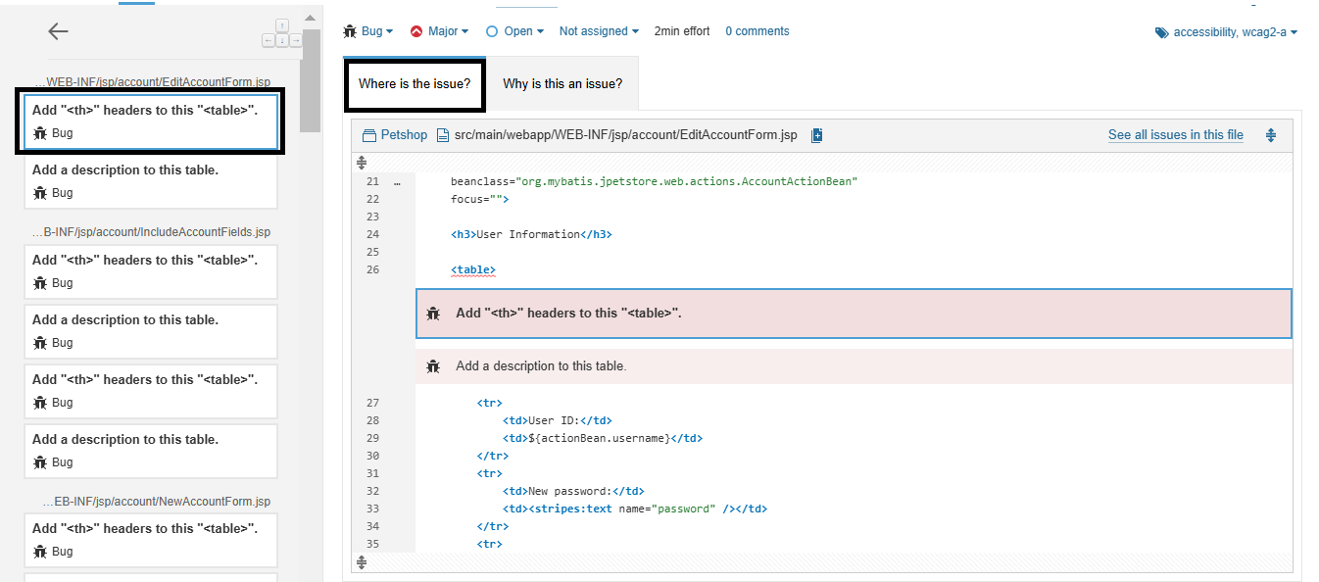
the bug is Add “<th>”headers to this “<table>”.
In the bug where is the issue ? Its shown below:

Slide 50
And next what is this an issue in the bug is shown below :
First thing in the bug is :
Assistive technologies, such as screen readers, use <th> headers to provide some context when users navigates a table. Without it the user gets rapidly lost in the flow of data
Headers should be properly associated with the corresponding <td> cells by using either a scope attribute or headers and id attributes. See W3C WAI Web Accessibility Tutorials for more information.
This rule raises an issue whenever a <table> does not contain any <th> elements.
Compliant Solution
<table>
<tr>
<th scope="col">Name</th>
<th scope="col">Age</th>
</tr>
<tr>
<td>John Doe</td>
<td>24</td>
</tr>
<tr>
<td>Alice Doe</td>
<td>54</td>
</tr>
</table>

Slide 51
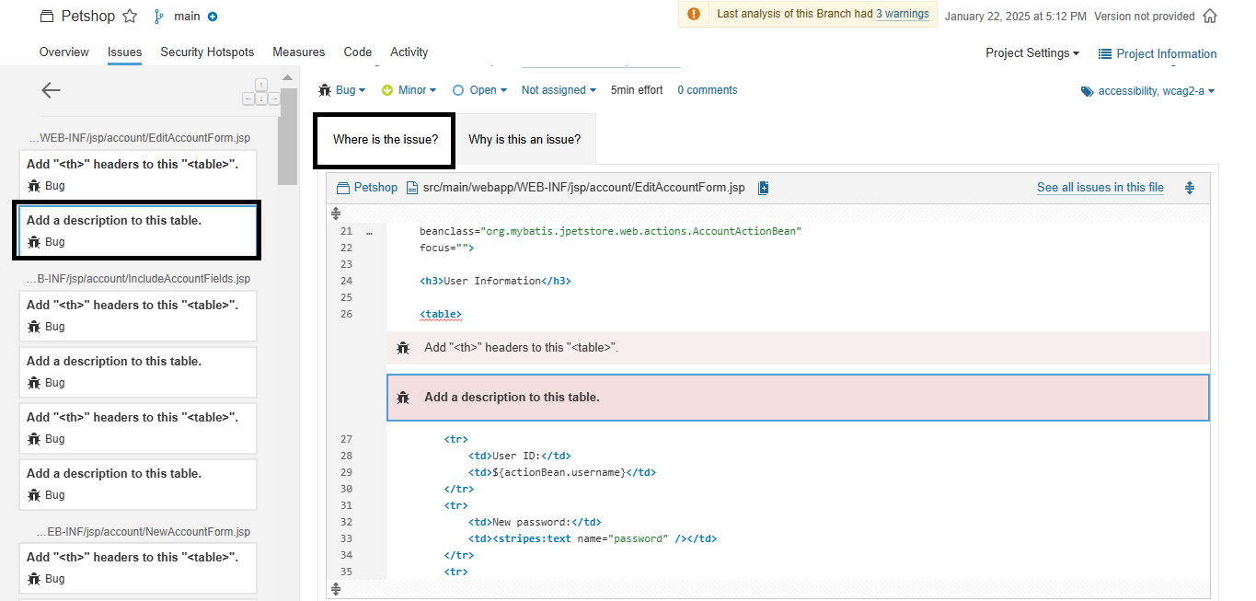
And next the bug is Add a description to this table.
In the bug where is the issue ?

Slide 52
And next what is this an issue in the bug is shown below :
In order to be accessible to visually impaired users, it is important that tables provides a description of its content before the data is accessed.
The simplest way to do it, and also the one recommended by WCAG2 is to add a <caption> element inside the <table>.
Other technics this rule accepts are:
adding a concise description via aria-label or aria-labelledby attributes in the <table>.
referencing a description element with an aria-describedby attribute in the <table>.
embedding the <table> inside a <figure> which also contains a <figcaption>.
adding a summary attribute to the <table> tag. However note that this attribute has been deprecated in HTML5.
Compliant Solution:
Adding a <caption> element:
<table>
<caption>New York City Marathon Results 2013</caption>
...
</table>

Slide 53
Adding an aria-describedby attribute.
<p id="mydesc">New York City Marathon Results 2013</p>
<table aria-describedby="mydesc">
...
</table>
Embedding the table in a <figure> which also contains a <figcaption>.
<figure>
<figcaption>New York City Marathon Results 2013</figcaption>
<table>
...
</table>
</figure>

Slide 54
Adding a summary attribute. However note that this attribute has been deprecated in HTML5.
<table summary="New York City Marathon Results 2013">
...
</table>
Exceptions
No issue will be raised on <table> used for layout purpose, i.e. when it contains a role attribute set to "presentation" or "none". Note that using <table> for layout purpose is a bad practice.
No issue will be raised either on <table> containing an aria-hidden attribute set to "true".

Slide 55
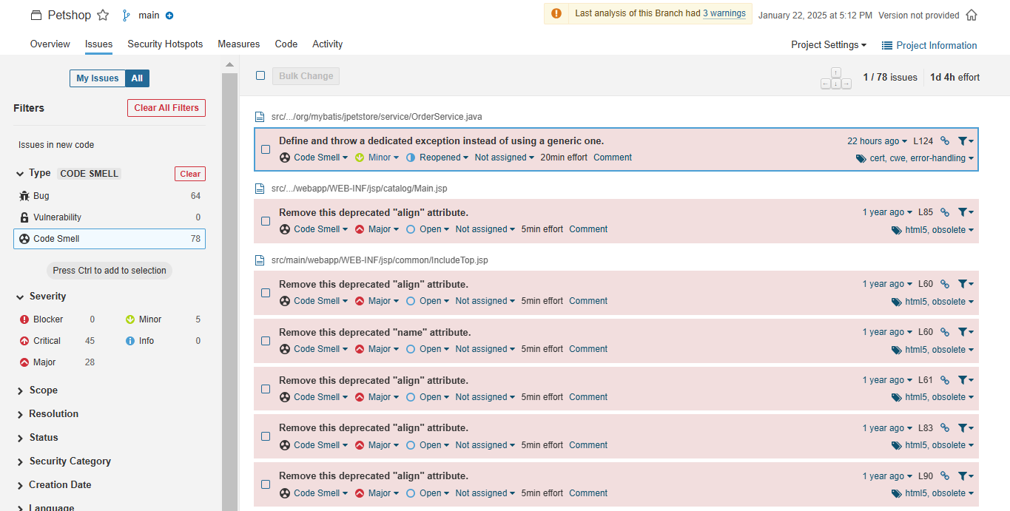
Code smell:
Code smell is a term used to describe parts of a codebase that might not be bugs or errors but indicate underlying problems, such as poor design, maintainability issues, or areas that could cause future problems. The term "smell" is used because these problems are not necessarily immediately harmful, but they suggest that something isn't quite right and could lead to more serious issues later.
Lets see some code smell:

Slide 56
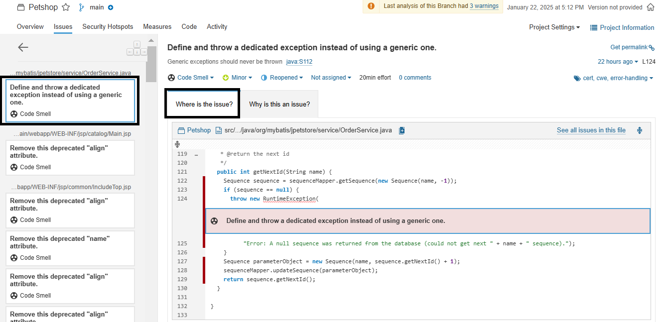
Lets see first is Define and throw a dedicated exception instead of using a generic one is shown below:

Slide 57
What is this issue ?
Using such generic exceptions as Error, RuntimeException, Throwable, and Exception prevents calling methods from handling true, system-generated exceptions differently than application-generated errors.
Compliant Solution:
public void foo(String bar) {
throw new MyOwnRuntimeException("My Message");
}
Exceptions
Generic exceptions in the signatures of overriding methods are ignored, because overriding method has to follow signature of the throw declaration in the superclass. The issue will be raised on superclass declaration of the method (or won’t be raised at all if superclass is not part of the analysis).
@Override
public void myMethod() throws Exception {...}
Generic exceptions are also ignored in the signatures of methods that make calls to methods that throw generic exceptions.
public void myOtherMethod throws Exception {
doTheThing(); // this method throws Exception
}

Slide 58
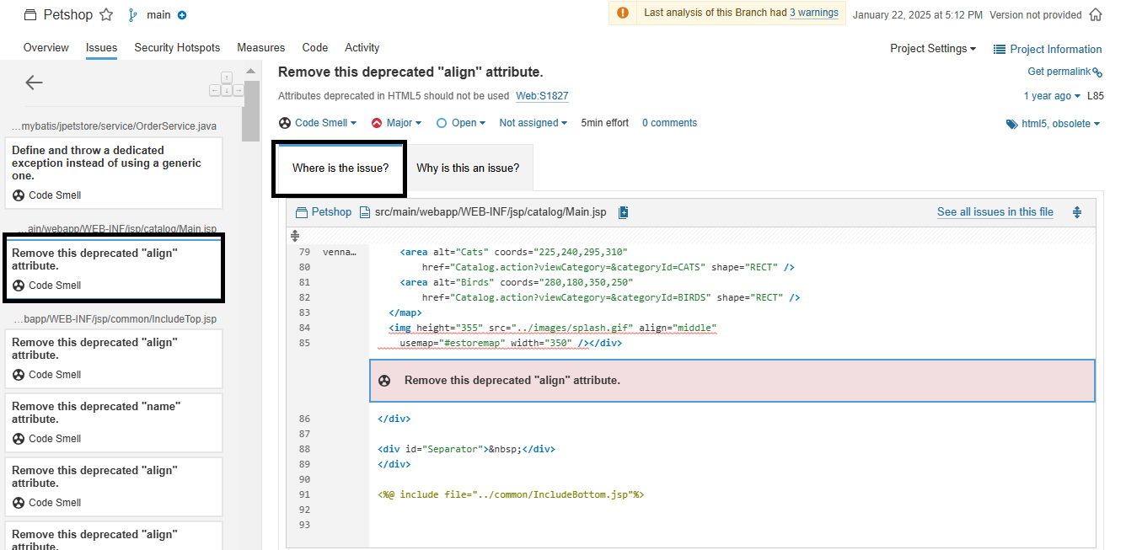
Remove this deprecated "align" attribute is shown below:

Slide 59
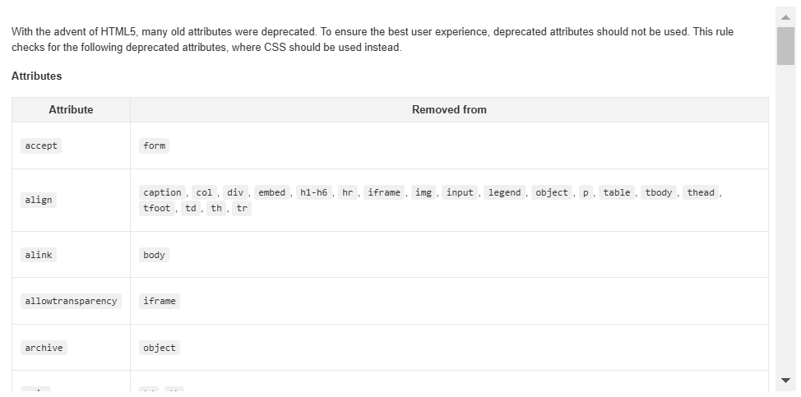
Why is this an issue ? Is shown below :

Slide 60


